Slide 1
Business Review For the Month of April ‘10

Slide 2
Project Management
Review

Slide 3
Planning & Design
Planning and Design Item | Status | Next Steps
Master Plan | Completed | Landscape GFC drawings – Target June 2010
Master Landscape Plan | Ph-1 – Schematic design completed. Ph-2 – Concept design 25% complete - Target date June 2010 | Ph-1 – Material codes and schedule of finishes - Target May 2010 Ph-2 – Schematic design - Target July 2010
Architectural Plans | Ph-1 - GFC for Phase 1A completed. Ph -1 - GFC for Ph- 1B to 1D in progress. Ph-2 – Schematic Design completed. Foundation details being worked out. | Ph-1 – Release of GFC for Ph-1B to 1D Ph-2 - Detailed Design for Architectural and services 100% completed. Structural 25% complete. – Target May 2010 Ph-2 – Civil Tender in progress - Target May 2010

Slide 4
Permits / Approvals

Slide 5
Development Cost and Disbursements
Payment Category | Current payments (in INR Millions)
 | Up to Mar 10 | Month of Apr 10 | Up to Apr 10
Construction payments ( for the core construction packages) | INR 4,30,91,417.00 | INR 44,07,041.00 | INR 4,74,98,458.00
Non-Construction payments ( excluding land cost but including fees of HOK, AI, Edifice & CBRE and similar other expenses) | INR 8,64,06,795.00 | INR 18,62,646.00 | INR 8,82,69,441.00
Total | INR 129,498,212.00 | INR 62,69,687.00 | INR 13,57,67,899.00

Slide 6
OUTLOOK -- Projected payments
 |  | May-10 | Jun-10 | Jul-10
Construction payments (projected payments based on current situation) | Contractor Payment | INR 2,05,78,571.00 | INR 2,19,68,286.00 | INR 1,62,32,857.00
 | MRDL Supply Items | INR 76,70,000.00 | INR 81,06,050.00 | INR 56,55,000.00
 | Sub Total | INR 2,82,48,571.00 | INR 3,00,74,336.00 | INR 2,18,87,857.00
Construction payments – from CF projection (projected payments based on approved budgeted cash flow or Business Plan cashflow) |  | INR 28,329,000.00 | INR 38,306,000.00 | INR 2,95,46,000.00
Variance |  | INR 80,429.00 | INR 82,31,664.00 | INR 76,58,143.00

Slide 7
COST PLAN
AC CODE | Package Number | Package Description | Phase 1 Budget | Based on Contract Awarded As on Date
A | A | CONSTRUCTION EXPENSES
 |  | Pre Construction Cost
 | 01 | Package 01 Soil Testing | 350,000 | 350,000
 | 02 | Package 02 Bush Clearance | 450,000 | 450,000
 | 03 | Package 03 Site Survey & Others | 250,000 | 250,000
 | 04 | Package 04 Temporary Utilities | 100,000 | 100,000
 | 05 | Infrastructure Works | 64,695,456 | 64,577,043
 |  | (Road, Pavement, Storm water Drain & External Sewer)
 | 06 | Boundary Wall Works | 16,352,386 | 16,003,034
 | 07 | Entry & Allied Works | 5,508,341 | 5,281,655
 | 08 | MWC Related Works | 22,409,252 | -
 |  | (South & North Roads, Lake Embankment, Drain Cover BY MS Frame & PVC Mesh)
 | 09 | Landscape & Hardscape Works | 79,127,851 | -
 | 10 | Club House / Maintenance Office Interiors, S.Pool Works | 41,837,185 | -
 | 11 | Procurement Package (Elevator System Only ) | - | -
 | 12 | Civil & Structural works (Including Employer Supplied Items) | 670,694,777 | 665,158,833
 | 13 | Plumbing Works - Internal & External (Including Employer Supplied Items) | 75,415,575 | 75,138,793
 | 14 | Electrical Works - Internal & External | 63,148,980 | 61,200,923
 | 15 | Security system, Communication system | 12,128,130 | -
 | 16 | Generator System | 8,694,000 | -
 | 17 | Fire Protection Works | - | -
 | 18 | Miscellaneous works | - | -
 | 19 | SEZ Benefits Cost | (50,475,304) | (38,864,131)
 |  | Total A : Construction Expenses | 1,010,686,629 | 849,646,151

Slide 8
Construction Progress
Milestones as per schedule | Description of work | Number of Days to Target Completion as of 05.05.10 | Original Target Completion Date | Estimated Completion Date | Number of Days Ahead/(Delayed) | REMARKS
Civil Works - Phase 1A
Milestone – 2 | Upto Ground Floor Roof Slab | 118 | 31-Aug-10 | 30-Sep-10 | 30 | Inadequate Manpower and insufficient slab shuttering Material
Milestone – 3 | Upto First Floor Roof Slab | 148 | 30-Sep-10 | 25-Oct-10 | 25
Milestone – 4 | Completion of Head Room | 179 | 31-Oct-10 | 31-Oct-10 | 0
Milestone – 5 | Masonry, plastering, tile finishes & Joineries | 330 | 31-Mar-11 | 15-April-11 | 0
Infra Works
 | Infra works | 235 | 25-Dec-10 | 25-Dec-10 | 0
Civil Works – Phase 1B
Milestone – 1 | Piling and plinth Completion | 87 | 31-Jul-10 | 31- Jul-10 | 0

Slide 9
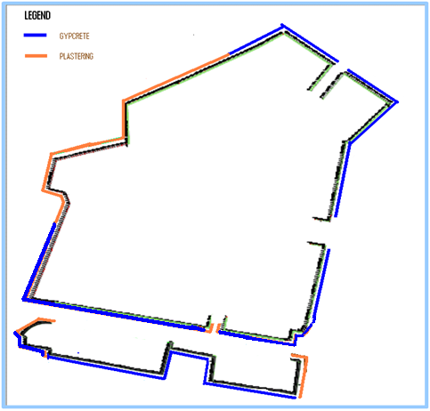
Boundary wall Progress Tracker as on 30- April 2010
S.No | Description of works | UOM | Over all Qty | Completed Qty | % of completion
1 | PILING | No | 764 | 764 | 100%
2 | PLINTH BEAM | M | 2570 | 2570 | 100%
3 | SOLID BLOCK WORK | M | 2570 | 2570 | 100%
4 | EXTERNAL PLASTERING | M | 2570 | 2570 | 100%
5 | GYPCRETE ERECTION | M | 2370 | 1700 | 72%

Slide 10
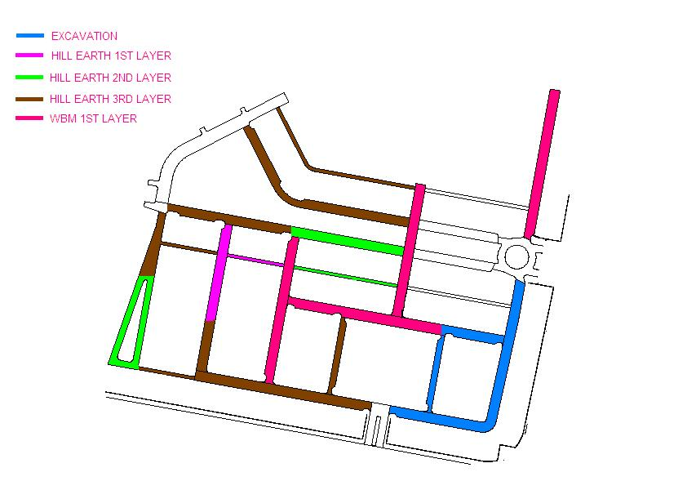
Road Works – Progress Tracker
ROAD WORKS
 | Road Excavation | Hill earth Filling Layer 1 | Hill earth filling Layer 2 | Hill earth filling Layer 3 | WBM Layer 1 | Total QTY in Mt
QTY completed | 2682 | 2127 | 1920 | 1575 | 326 | 3083
% of completion | 86.99% | 68.99% | 62.28% | 51.09% | 10.57%

Slide 11
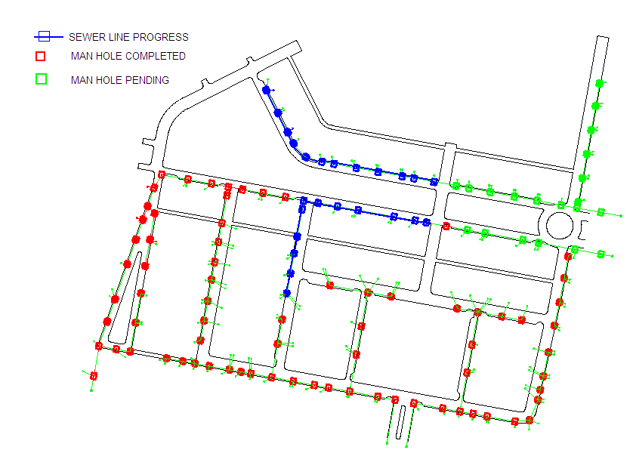
Sewer line – Progress Tracker
SEWER LINE
Total Manholes | 119 | Total Qty for Stone ware pipe | 2092
Completed | 110 | Completed | 246
% of completion | 92.44% | % of completion | 11.76%

Slide 12
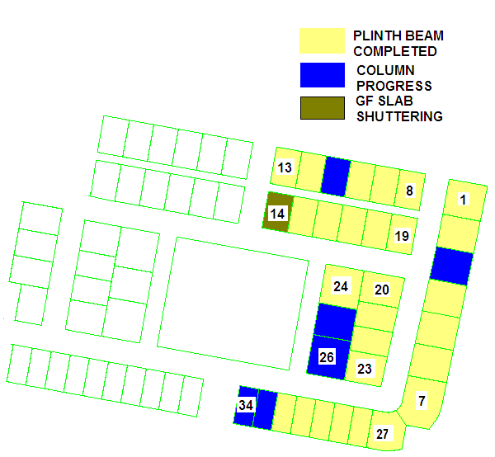
Villa – Progress Tracker
Phase 1A
S.No. | Activity | UOM | Total Qty. | Completed Qty. | % of completion
1 | Columns | NOS | 739 | 68 | 9.20%
2 | GF Slab | NOS | 41 | 0 | 0.00%
3
UG SUMP
S.No. | Activity | UOM | Total Qty. | Completed Qty. | % of completion
1 | Excavation | cum | 2300 | 2300 | 100.00%
2 | Plum concrete | Nos | 21 | 21 | 100.00%
3 | Filling of hill earth | cum | 612 | 18 | 2.94%

Slide 13
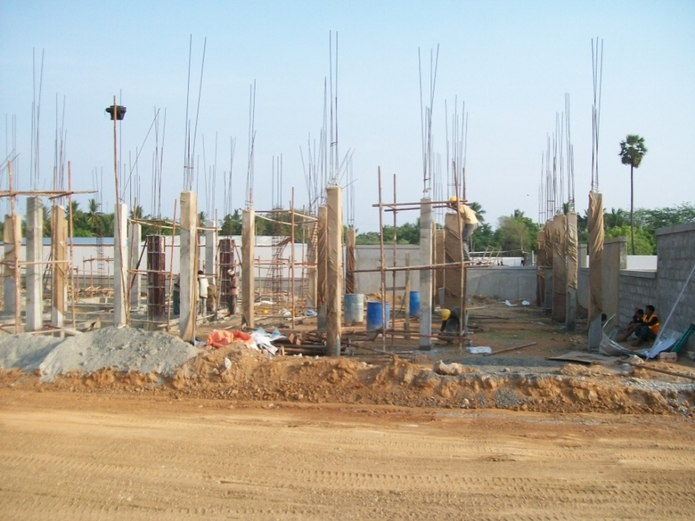
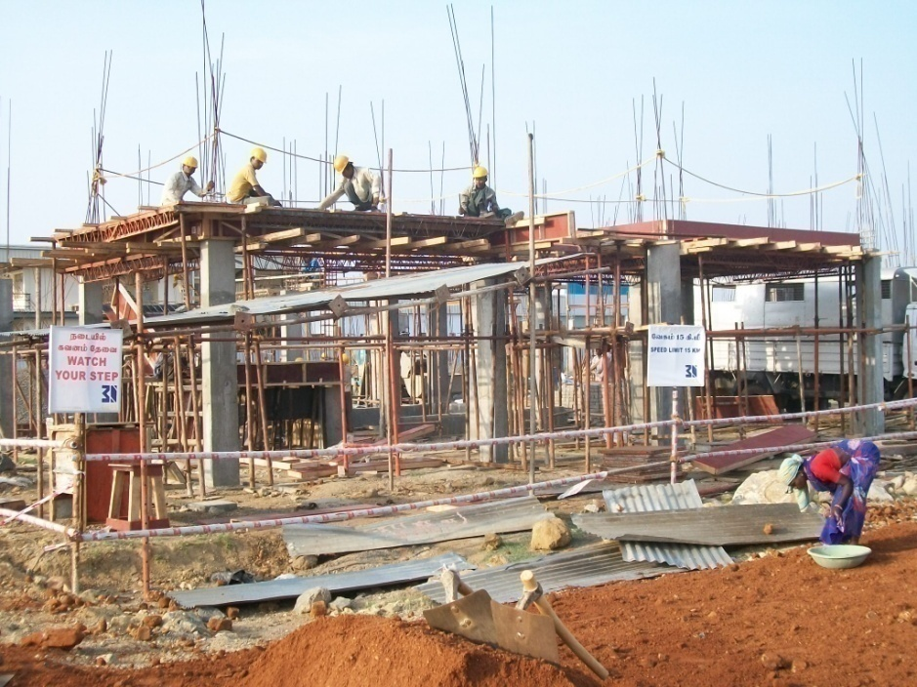
Site images (dated 30/04/10)
Villa – Column Rising Progress View
Villa – Slab Shuttering work - Progress View

Slide 14
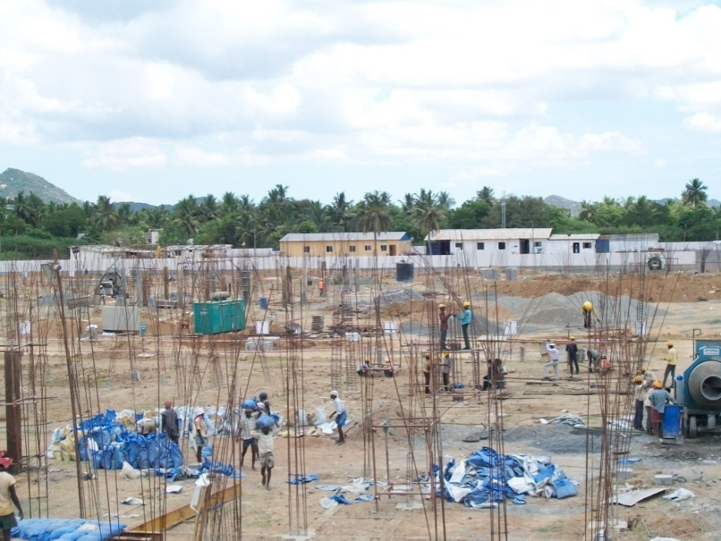
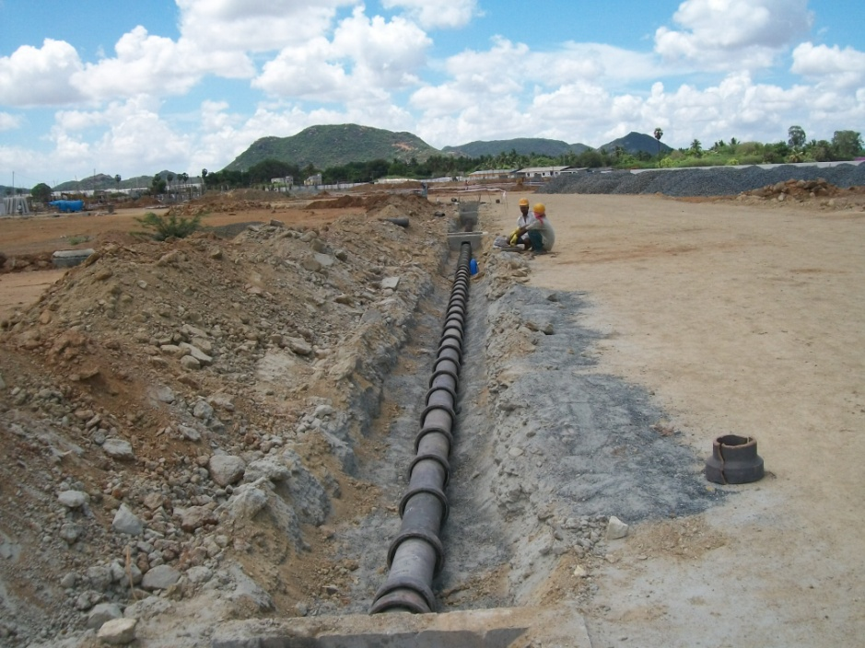
Site Images (dated 30/04/10)
Villa - Progress View
Sewer line progress

Slide 15
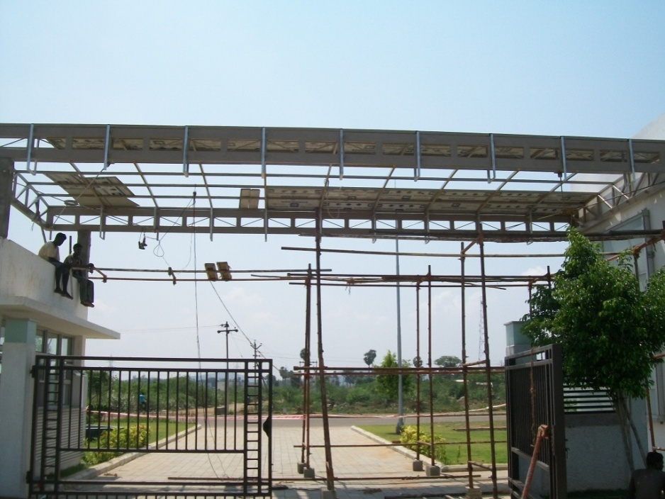
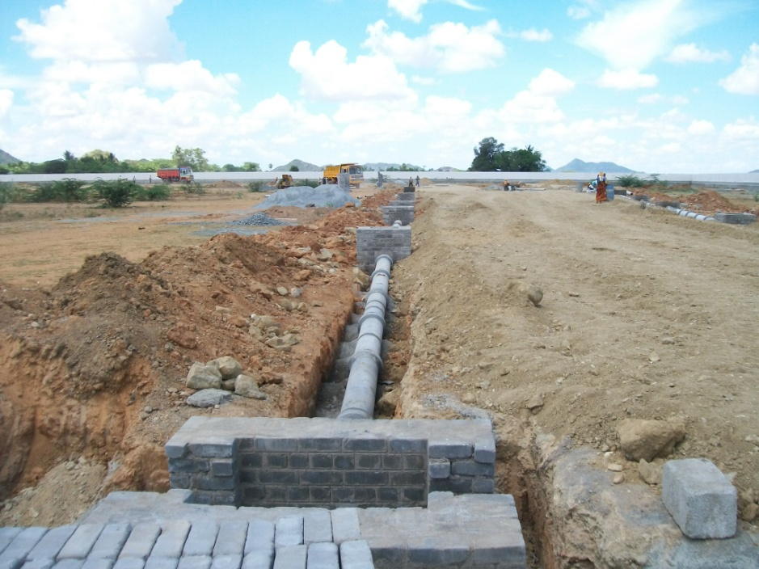
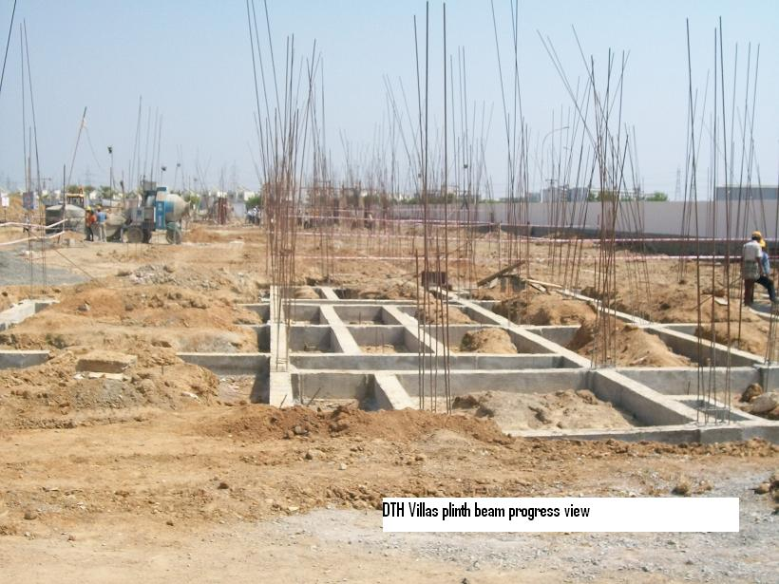
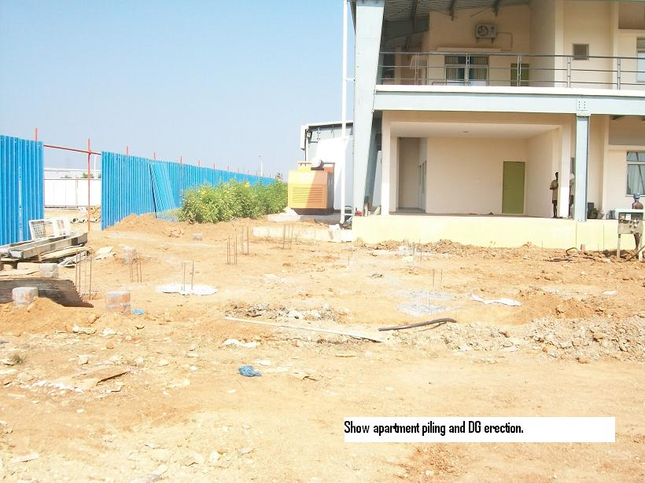
Site Images (dated 30/04/10)
Canopy Works – Progress View
Storm Water Line Progress View

Slide 16
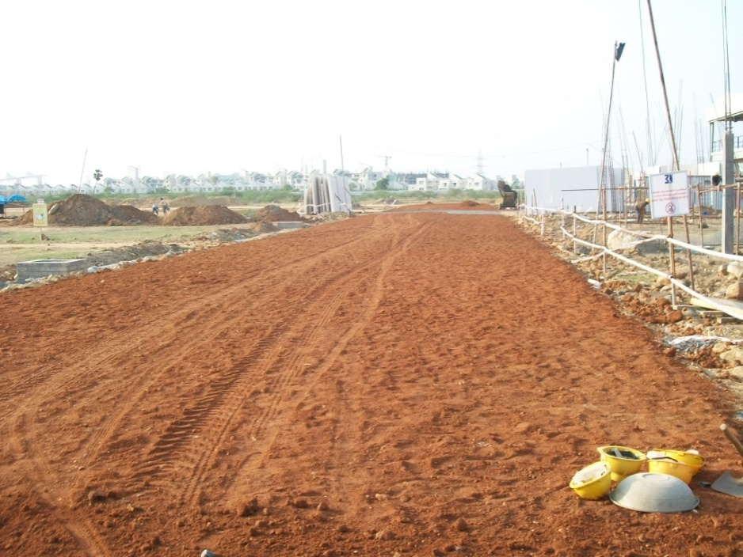
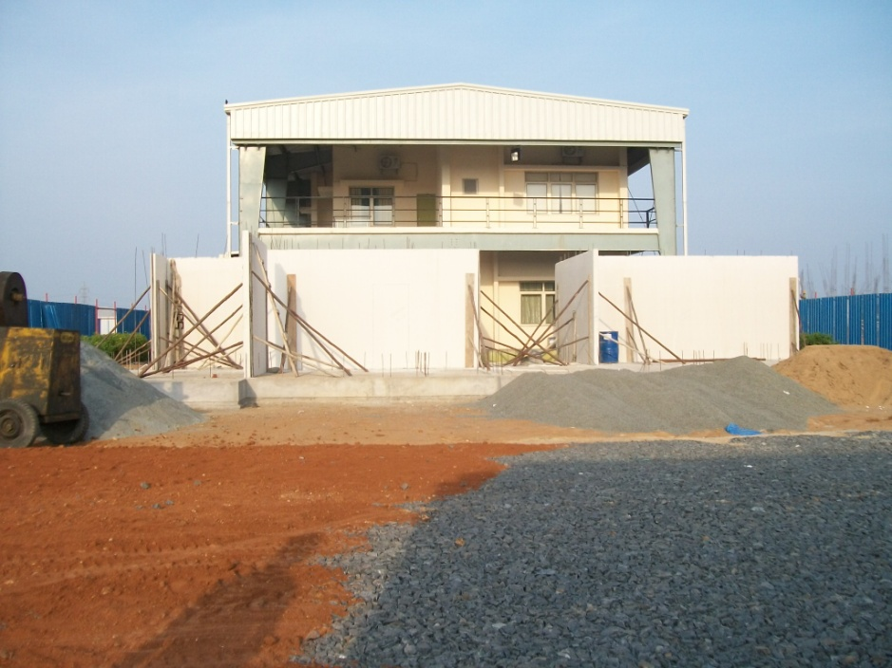
Site Images (dated 30/04/10)
Road Works WBM - Progress View
Show Apartment – Progress View

Slide 17
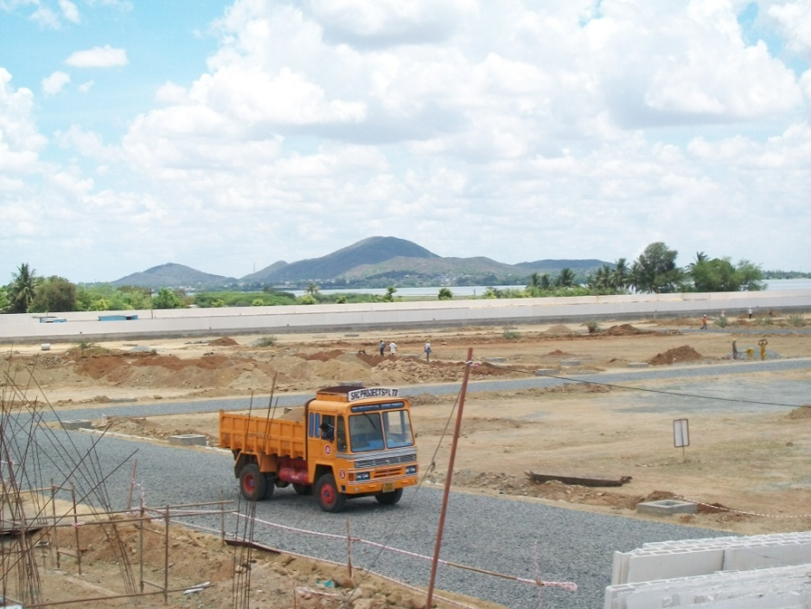
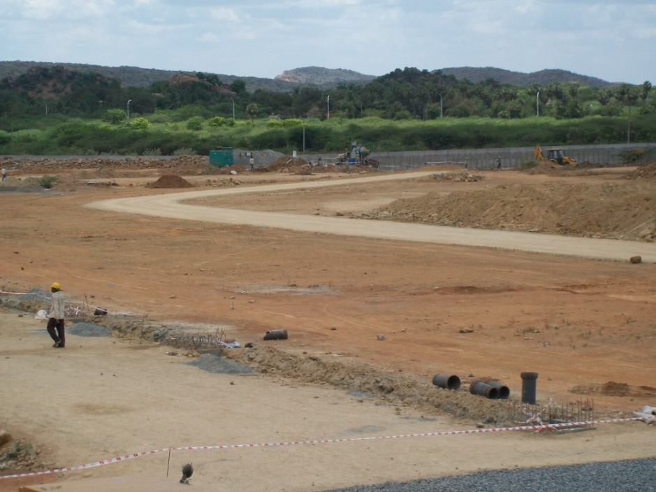
Site Images (dated 30/04/10)
Road Works WBM - Progress View
Road Work Progress View

